Slide 1
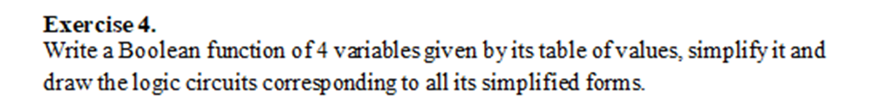
Individual homework Logic circuits Exercise 4
Gherman Paula-Sorana
Group 912

Slide 2
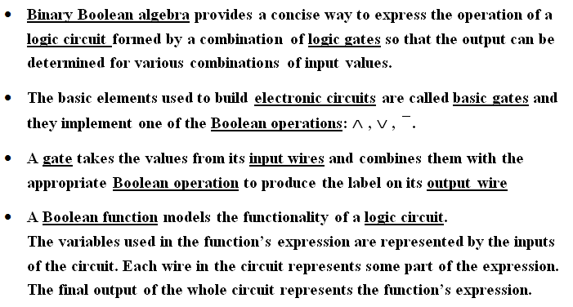
Theoretical results Definition of logic circuits

Slide 3
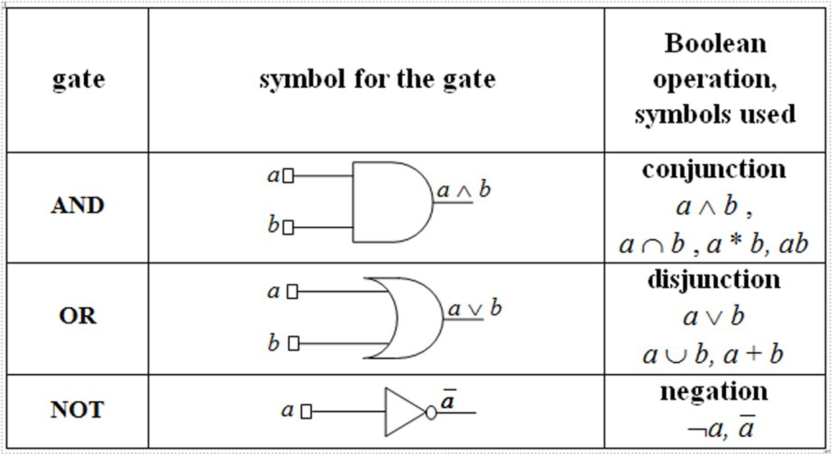
Theoretical results Basic gates

Slide 4
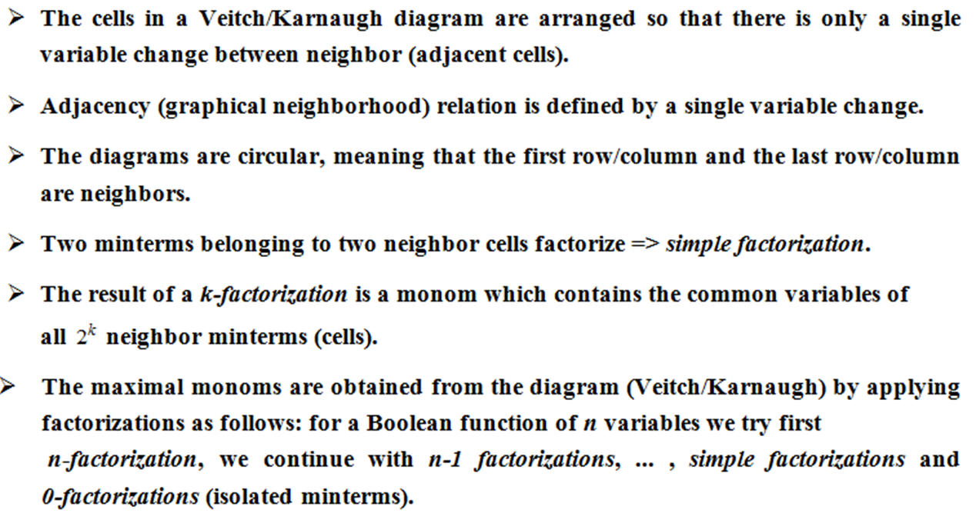
Theoretical results Veitch/Karnaugh diagrams

Slide 5
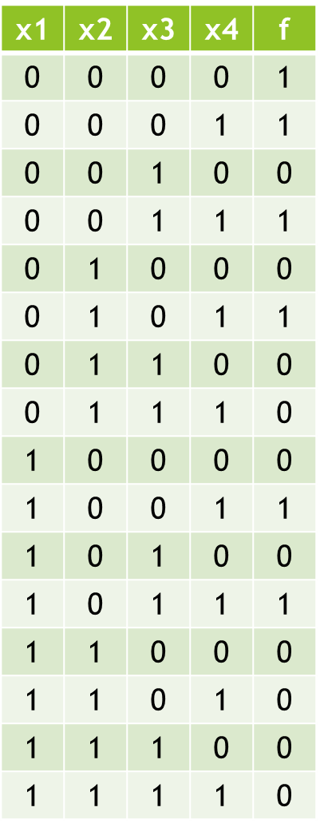
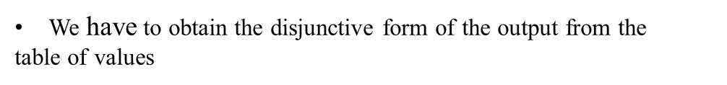
Solving the exercise Writing the function
= m0 v m1 v m3 v m5 v m9 v m11 =

Slide 6
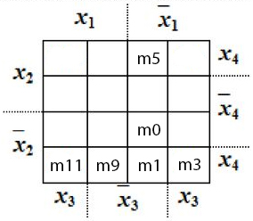
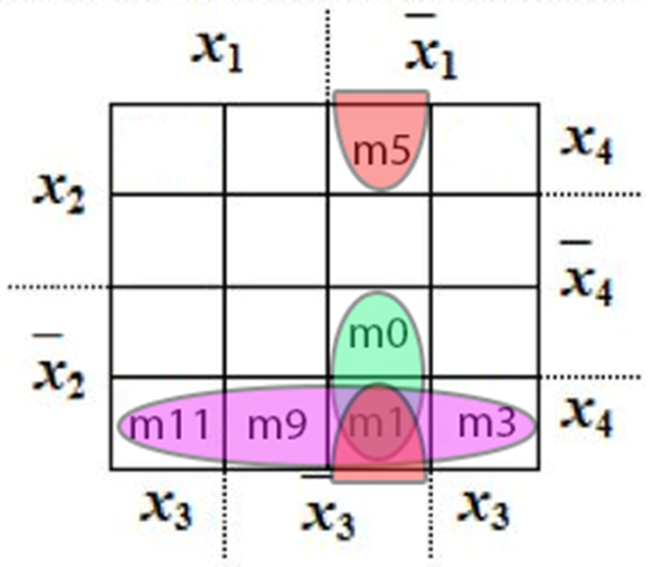
Solving the exercise Building the Veitch diagram

Slide 7
Solving the exercise Simplifying the Boolean function
The set of our maximal monoms is:
M(f) = {max1, max2, max3}
max1 = m1 v m3 v m9 v m11 = x4 (𝑥2) ̅ (double factorization)
max2 = m0 v m1 = (𝑥1) ̅ (𝑥3) ̅ (𝑥2) ̅ (simple factorization)
max3 = m1 v m5 = (𝑥1) ̅ (𝑥3) ̅ x4 (simple factorization)
All maximal monoms are central monoms, because each maximal monom contains (at least) a minterm circled once. Thus, we will use the first case of the simplification algorithm.
max1 is central because m11 is only circled once
max2 is central because m0 is only circled once
max3 is central because m5 is only circled once
There is a unique simplified form of f, obtained as the disjunction of all central monoms:
𝑓^𝑠=𝑚𝑎𝑥1 𝑣 𝑚𝑎𝑥2 𝑣 𝑚𝑎𝑥3= x4 (𝑥2) ̅ V (𝑥1) ̅ (𝑥3) ̅ (𝑥2) ̅ V (𝑥1) ̅ (𝑥3) ̅ x4

Slide 8
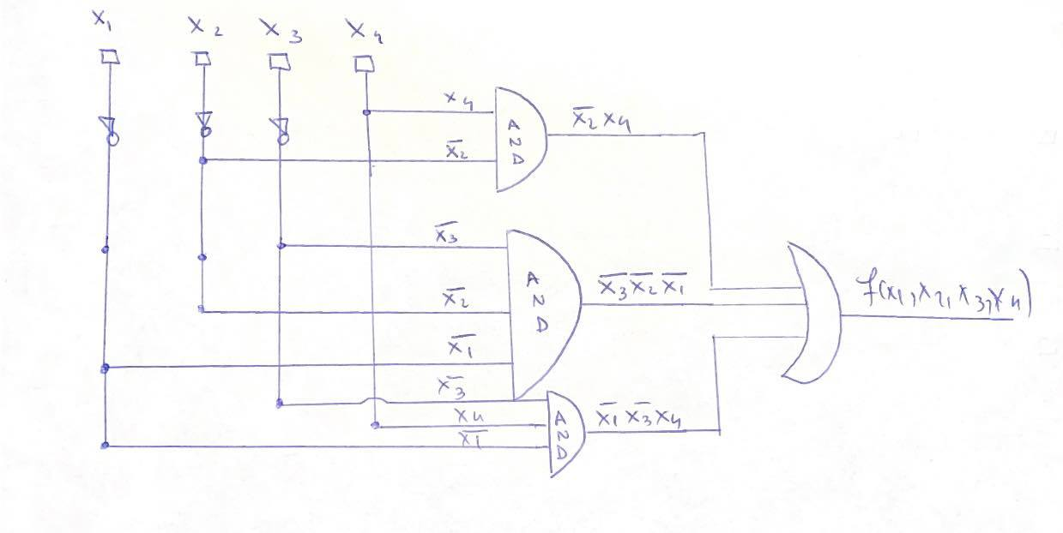
Conclusion The logic circuit

